Slide 1

Customer Life Time Value Prediction
GStore
Jyotsna Sateesh
Solving Tomorrow's Problems Today

Slide 2
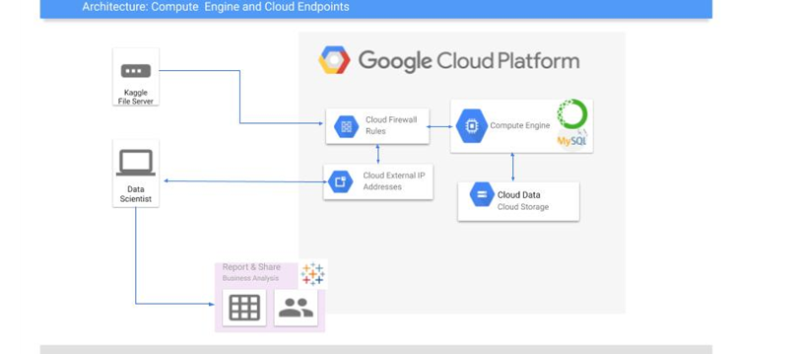
System Architecture:

Slide 3
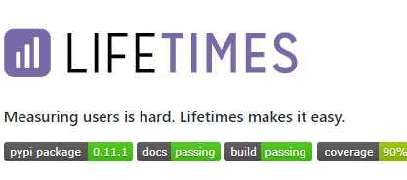
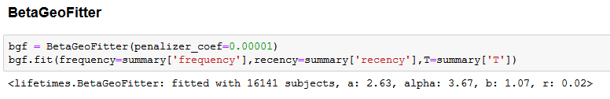
Frequency -The count of days the customer had a purchase on.
T- represents the age of the customer in whatever time units chosen .This is equal to the duration between a customer’s first purchase and the end of the period under study.
Recency - represents the age of the customer when they made their most recent purchases. This is equal to the duration between a customer’s first purchase and their latest purchase. (Thus if they have made only 1 purchase, the recency is 0.)

Slide 4
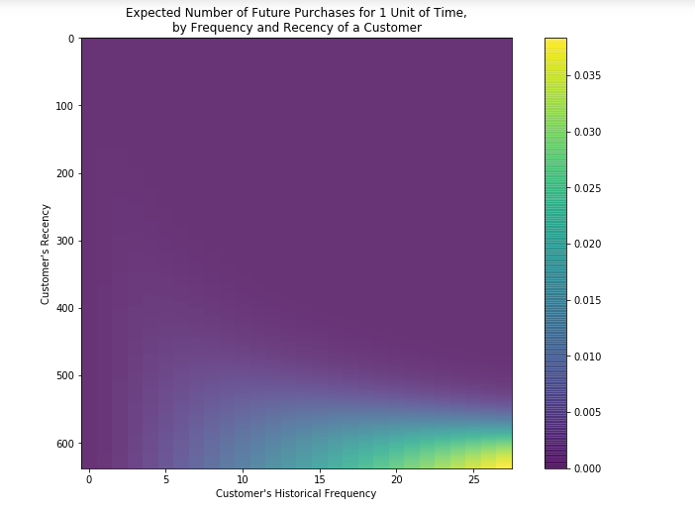
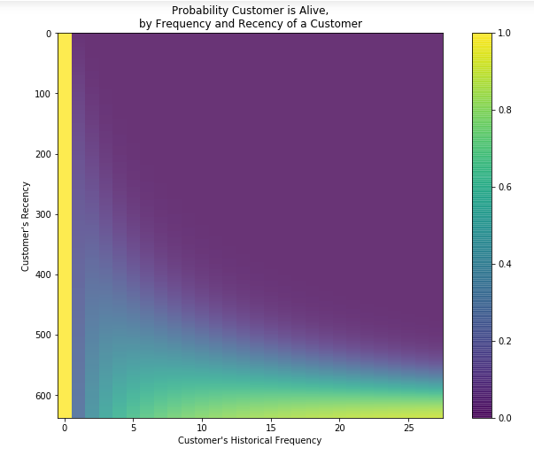


BetaGeoFitter-Basic Frequency/Recency analysis using the BG/NBD model

Slide 5
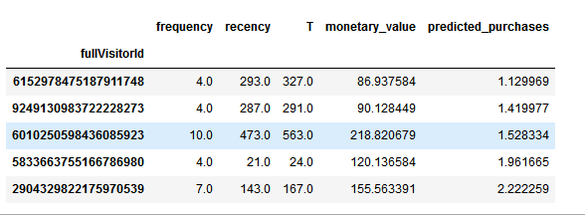
Top 5 Customers

Slide 6
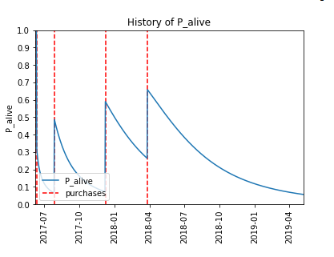
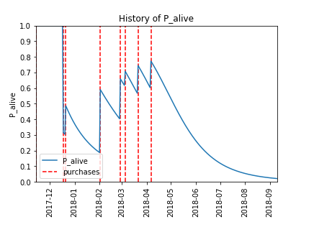
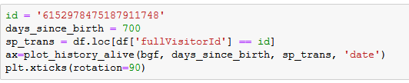
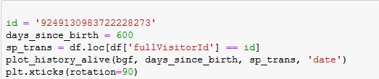
Customer Probability Histories

Slide 7
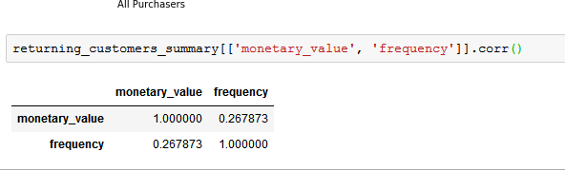
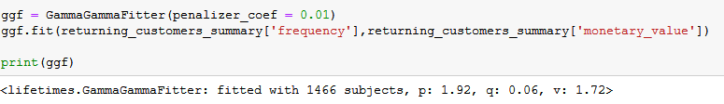
Gamma-Gamma model

Slide 8
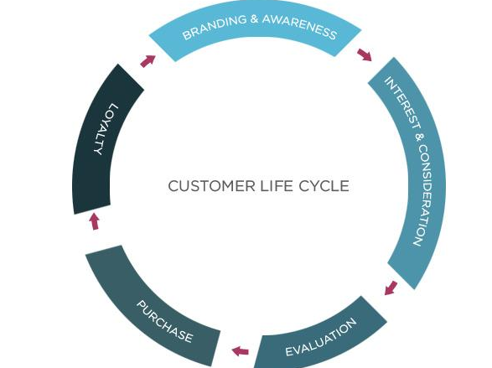
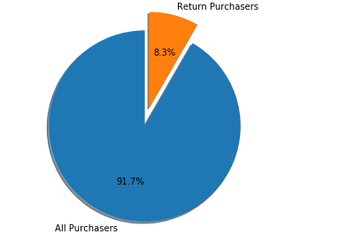
Customer Life Time Value

Slide 9
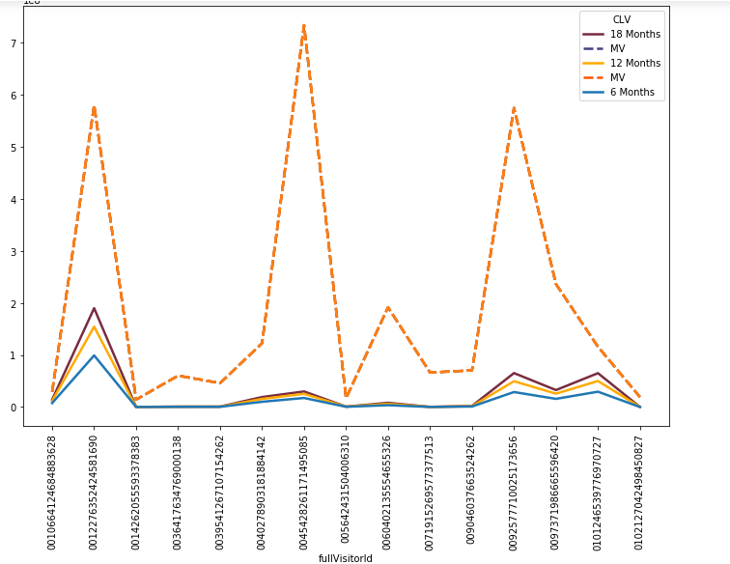
CLV for 18/12/6 Months & 0.01 Discount
Low End Customers

Slide 10
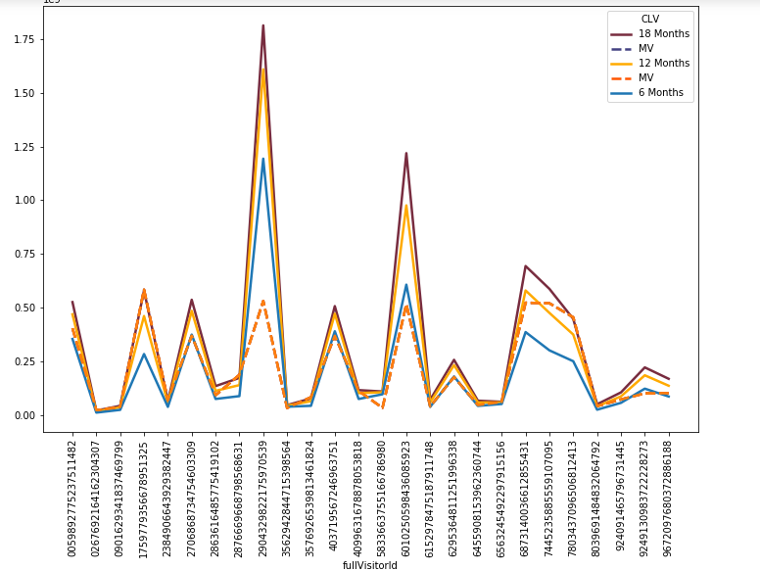
Top end customers

Slide 11
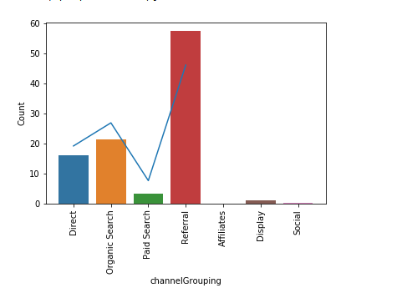
Needle in the Haystack

Slide 12
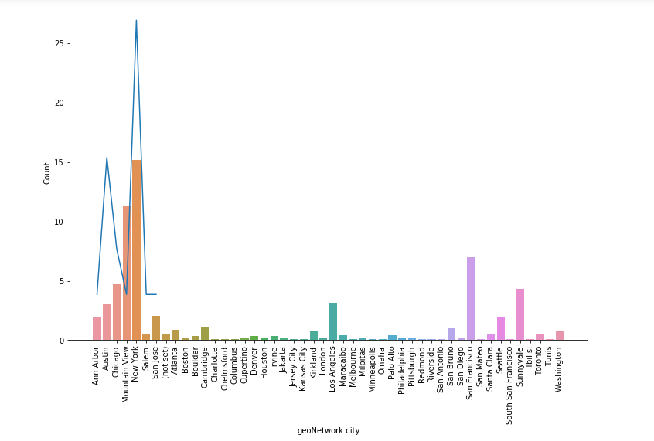
Contd...

Slide 13
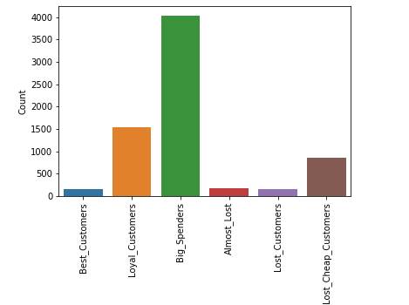
Customer Segmentation -RFM Analysis

Slide 14
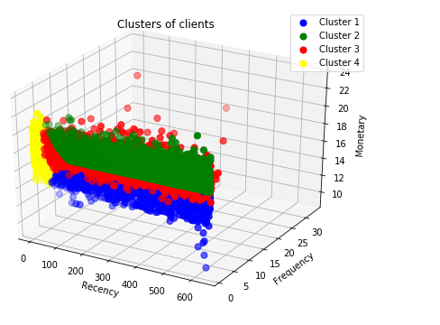
Kmeans Clustering

Slide 15
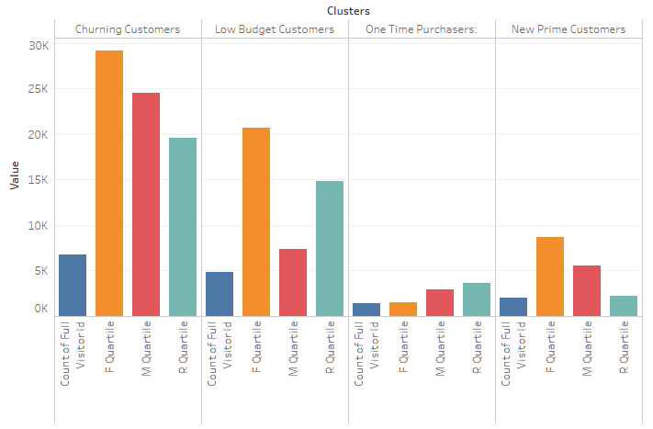
Interpretation

Slide 16
Way ahead
real CLV (rCLV) is a metric that bridges the waning gap between transactional and behavioral data,
Transactional databases (purchase behavior)
Accounting systems
Marketing databases (customer segment information);
Social data (social influence and engagement)
CLV-Marketing Toolbox

Slide 17


